Slide 1
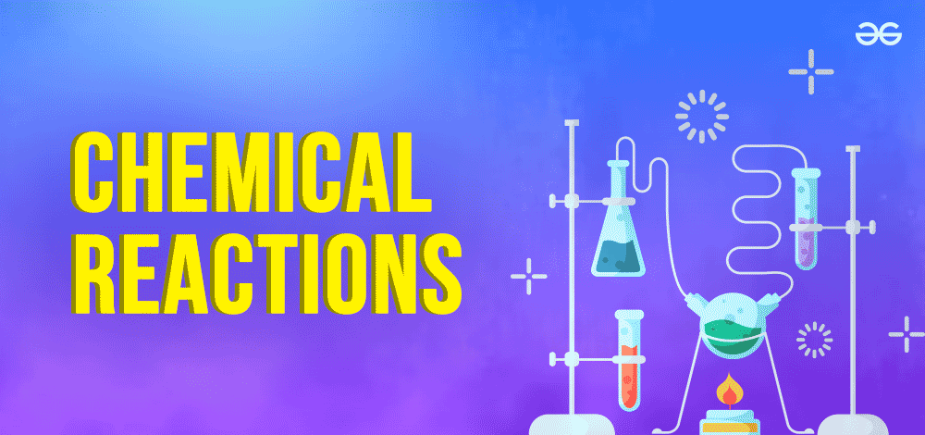

Slide 2
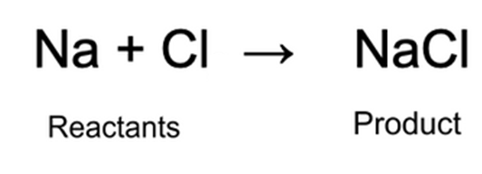
A chemical reaction is a process in which one or more substances, the reactants, are converted to one or more different substances, the products.

Slide 3
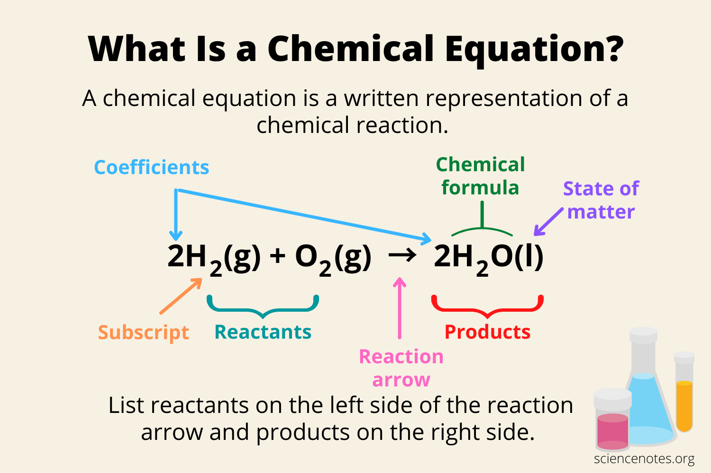

Slide 4
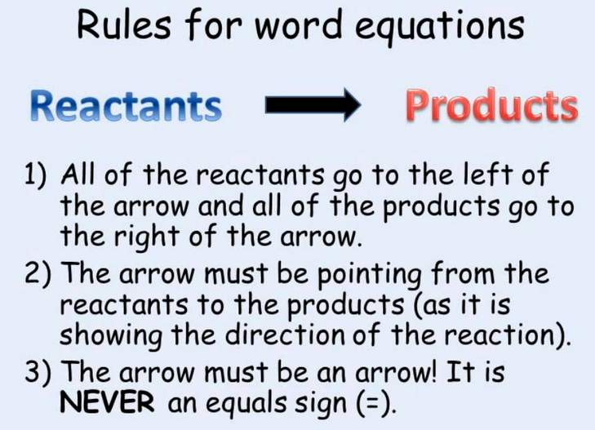

Slide 5
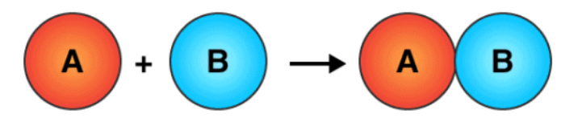
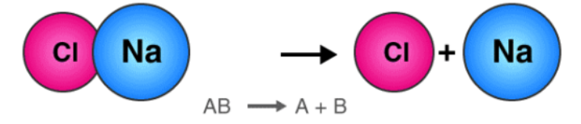
In a chemical reaction atoms rearrange, bonds are broken and formed, and something new is created.

Slide 6
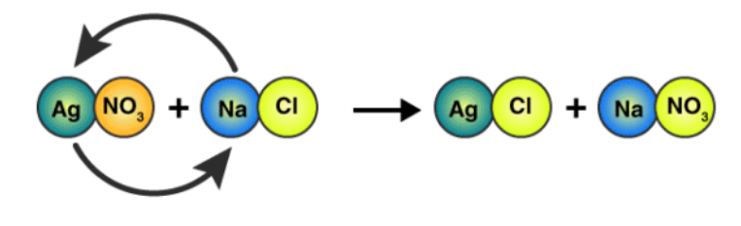

Slide 7
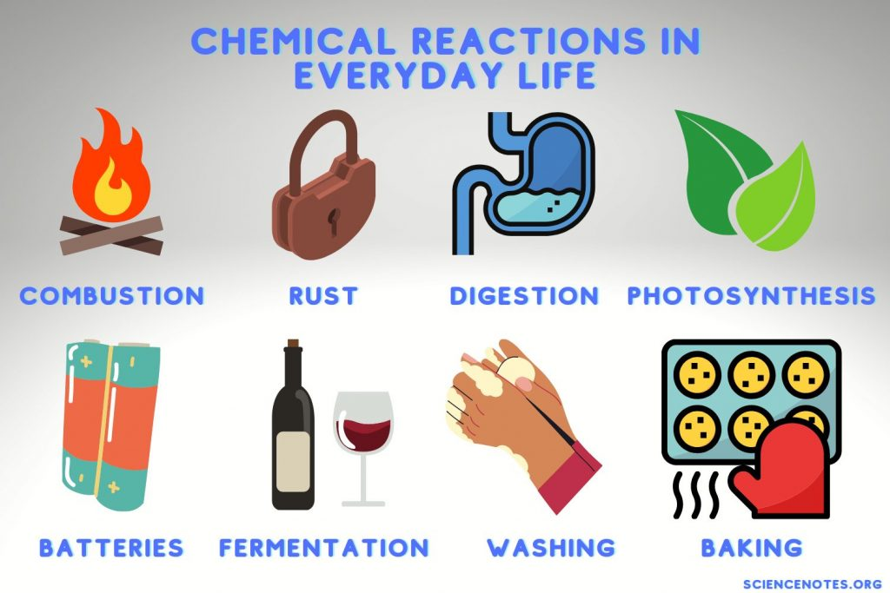

Slide 8
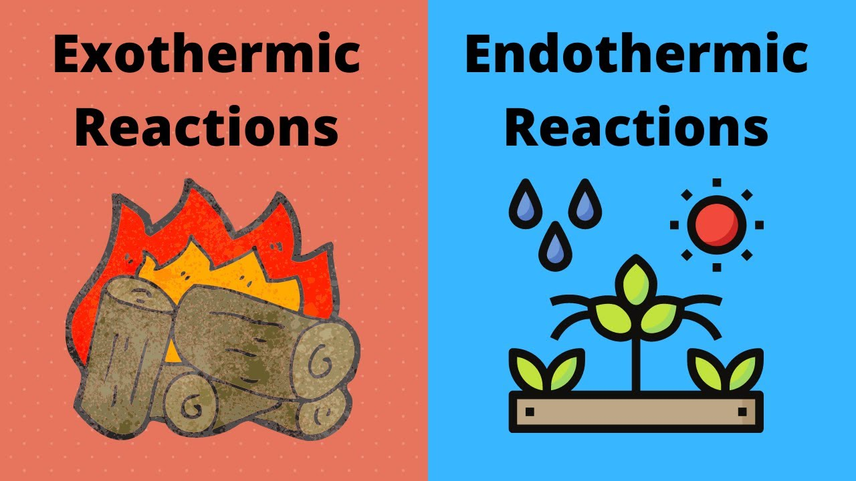
One important way to classify chemical reactions is by the energy they absorb or release.

Slide 9
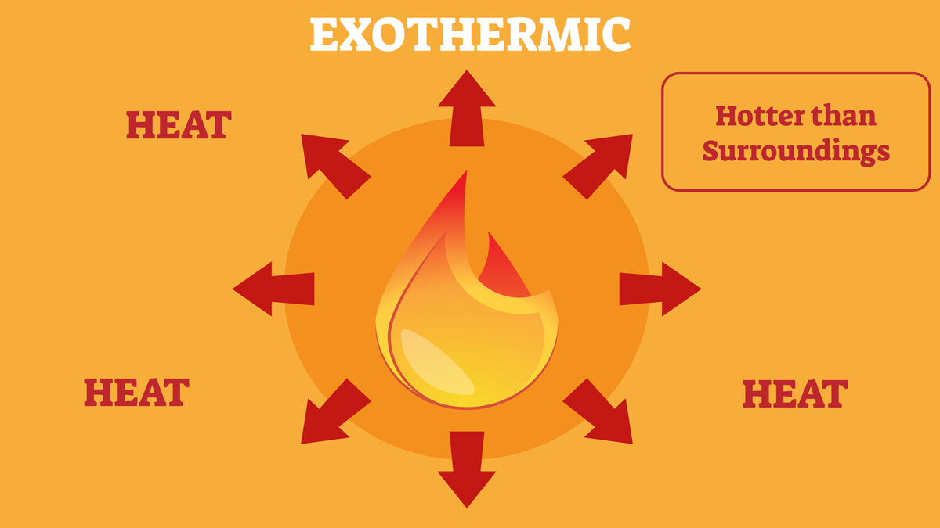
Exothermic reactions give off energy, often in the form of heat or light. Burning wood, for example, releases heat and light into the surroundings

Slide 10
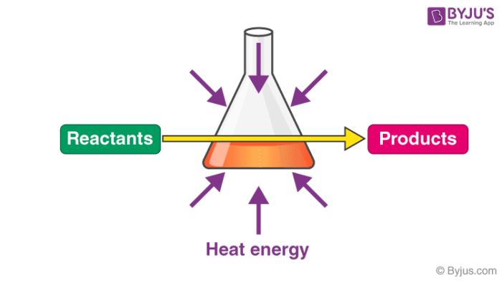
Endothermic reactions absorb energy. A common example is photosynthesis in plants, where energy from sunlight is taken in to make food.

Slide 11
