Slide 1
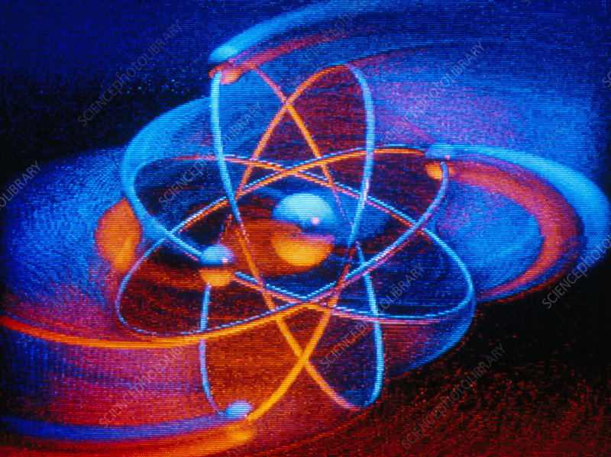
What’s inside an atom?
EIGHTH GRADE
MARYMOUNT SCHOOL
2025

Slide 2
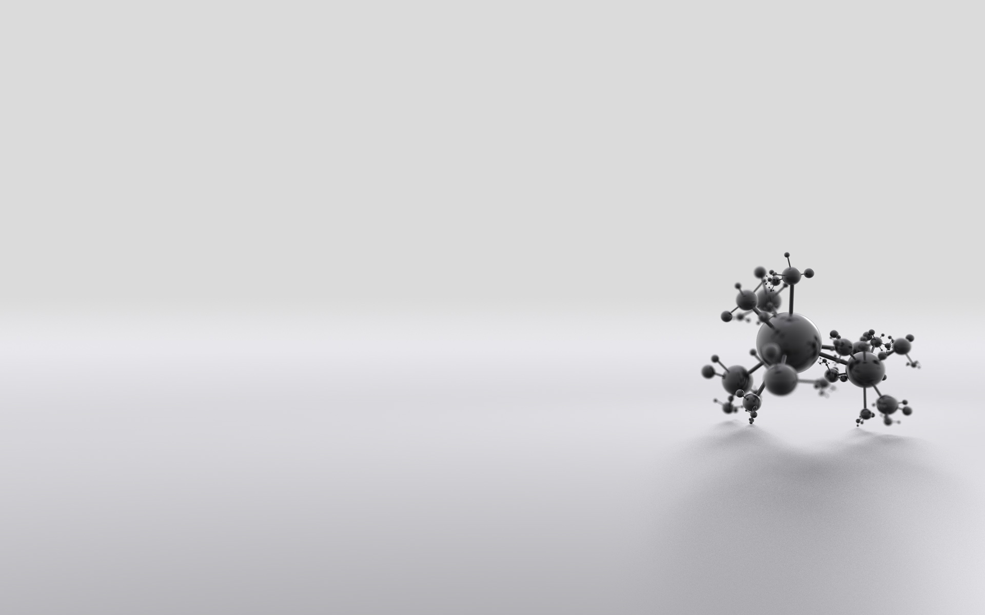
Vocabulary
Atom
Proton
Electron
Neutron
Mass number
Atomic number

Slide 3
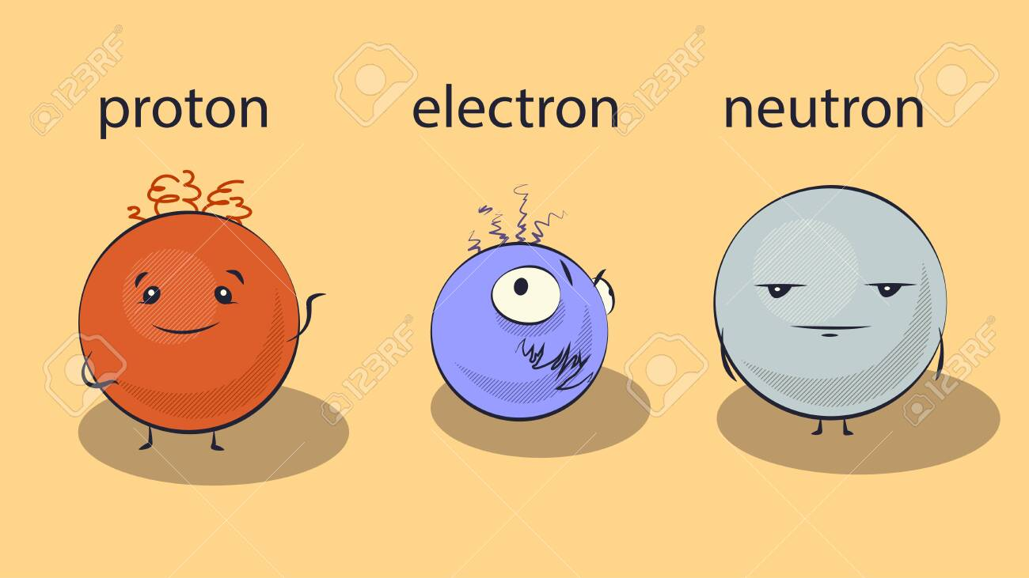
An atom is made of three parts – protons, neutrons and electrons.

Slide 4

Proton
Subatomic particle that has a positive electric charge. The nucleus of every atom contains at least one proton

Slide 5

Neutron
Subatomic particle that has the same mass as a proton but no electric charge. The nucleus may contain one or more neutrons

Slide 6
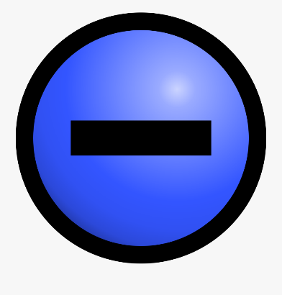
Electron
Subatomic particle that has a negative charge. It´s much smaller and has much less mass than a proton or a neutron. They orbit the nucleus at a great speed

Slide 7
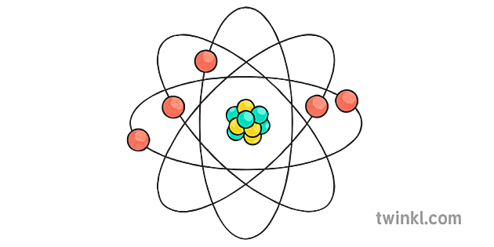
A neutral atom has equal number of protons and electrons

Slide 8
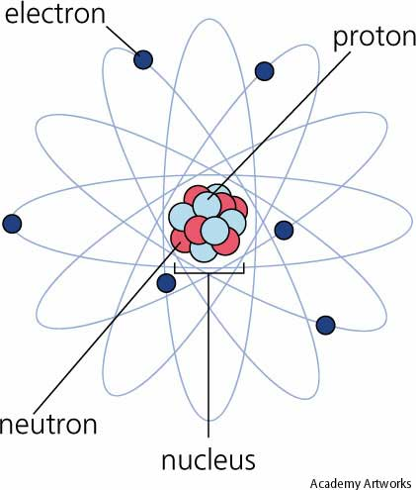
Mass number: Protons + Neutrons

Slide 9
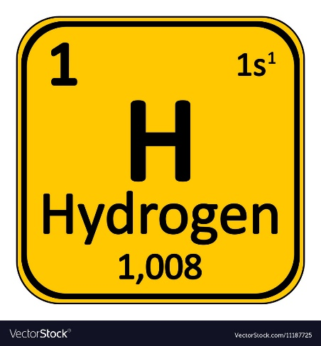
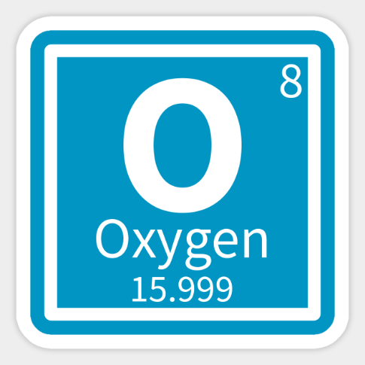
What is atomic number? (Z)
It is defined by the number of protons in the nucleus of an atom.

Slide 10
What is atomic mass? (A)
It’s equivalent to the number of protons and neutrons in the atom.
Atomic mass (A) =
#Protons + #Neutrons

Slide 11

Because the masses of particles in atoms are so small, they have their own unit.
The SI unit to express the masses of particles in atoms is the atomic mass unit (amu)
Each proton has a mass of about 1 amu
1 amu P+ = 0, 0000000000000000000000017 g

Slide 12
To calculate the atomic mass of a single atom of an element, add up the mass of protons and neutrons.
Example:
Find the atomic mass of a carbon atom that has 7 neutrons. You can see from the periodic table that carbon has an atomic number of 6, which is its number of protons. The atomic mass of the atom is the mass of the protons plus the mass of the neutrons, 6 + 7, or 13.

Slide 13
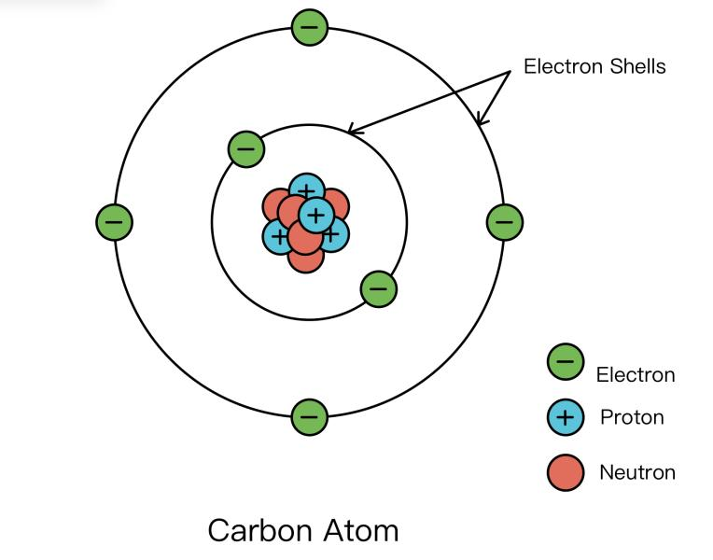

Slide 14
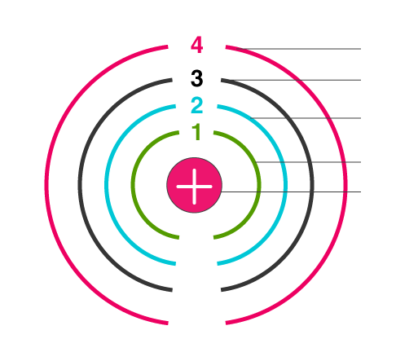
Electron shells are levels or spaces where electrons move around the nucleus

Slide 15
What makes elements different from one another?
The number of protons in the nucleus of an atom is the atomic number of an atom
All atoms of an element have the same atomic number
Different number of protons, different properties, different elements

