Slide 1
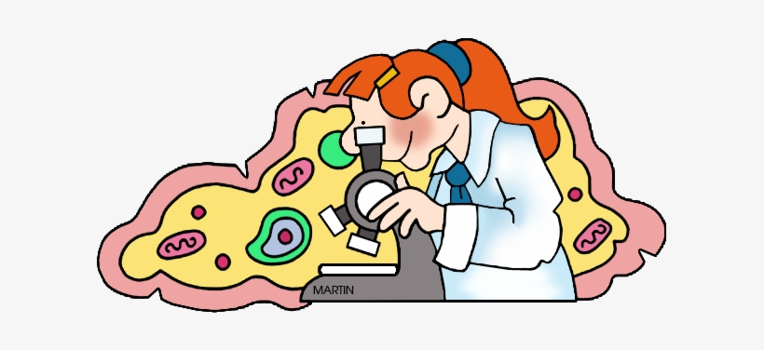
CELLS

Slide 2
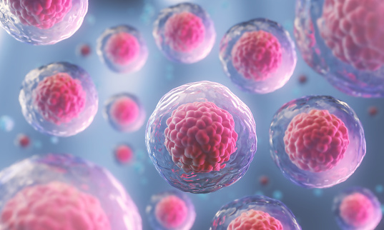
What are cells?

Slide 3
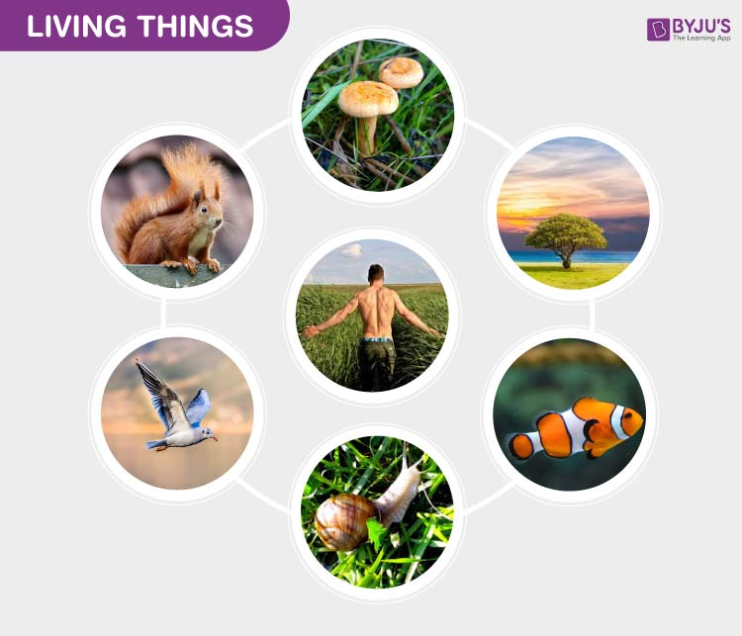
Every organism is made up of cells.
The cell is the smallest unit with the basic properties of life.
Some tiny organisms, such as bacteria and yeast, consist of only one cell.
Large plants and animals have many billions of cells. Human beings are made up of more than 75 trillion cells.

Slide 4

Do all cells look similar?

Slide 5
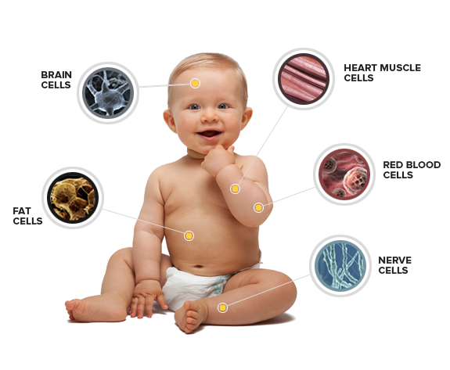

Slide 6
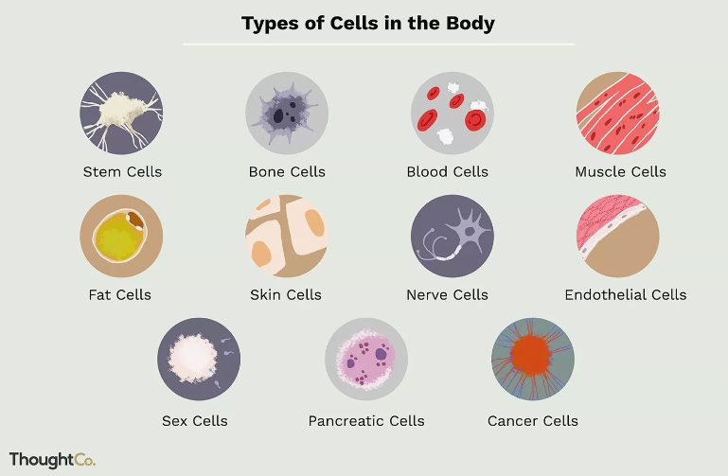

Slide 7
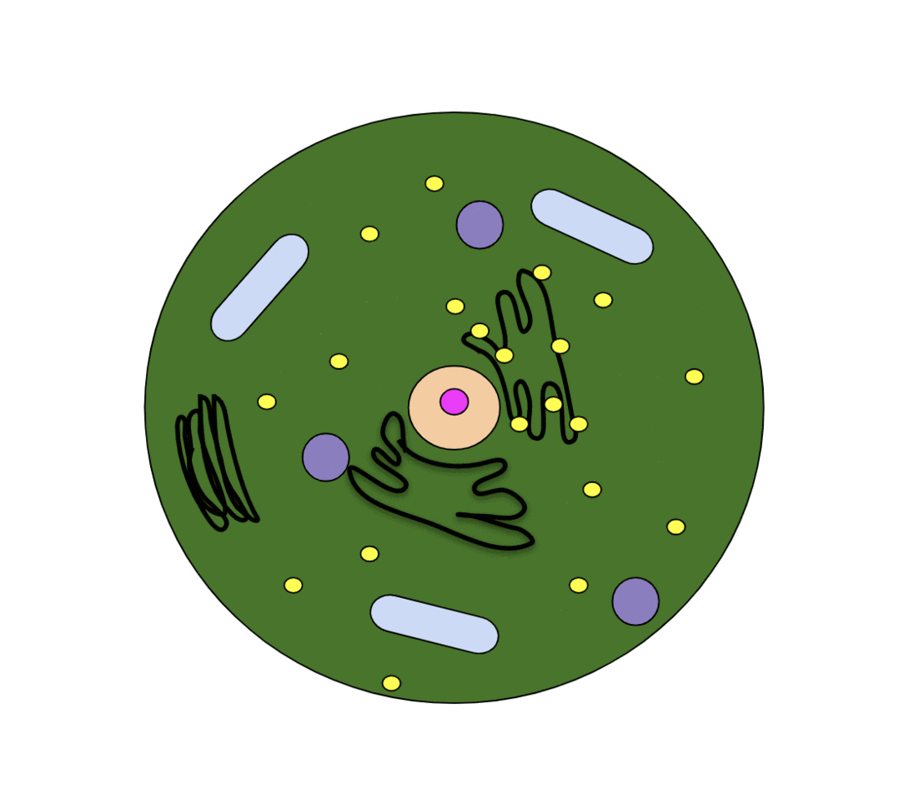
Let’s draw a cell!

Slide 8
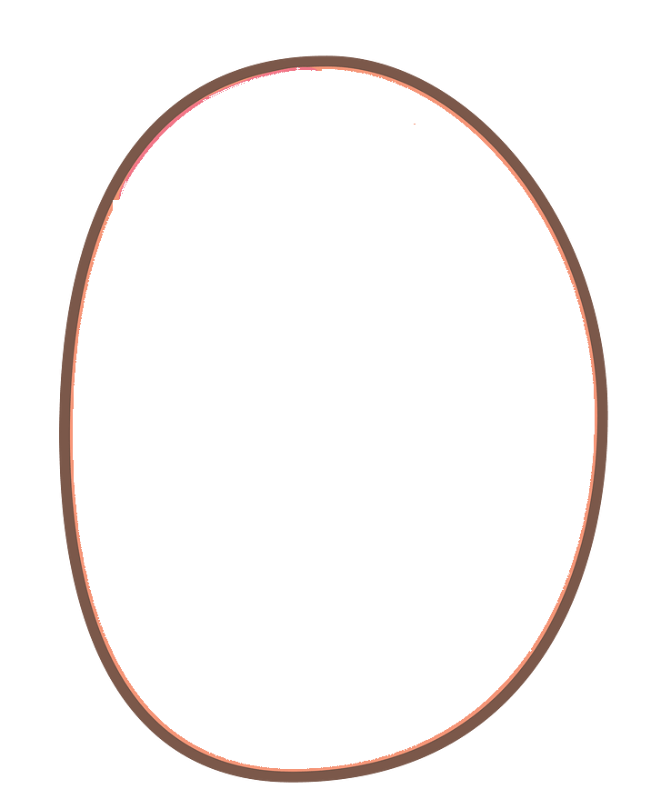
Cell Membrane
It separates the inside and the outside of the cell, and controls what goes in and comes out.

Slide 9
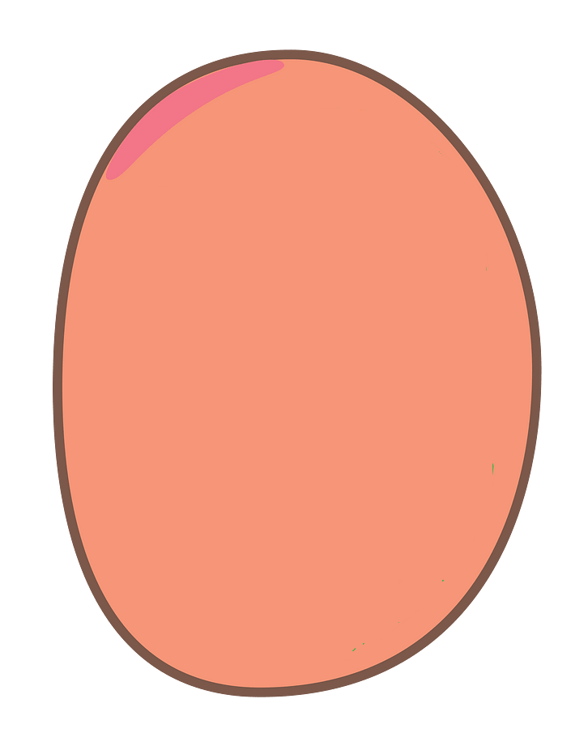
Cytoplasm
Jelly-like substance containing the cell’s parts.

Slide 10
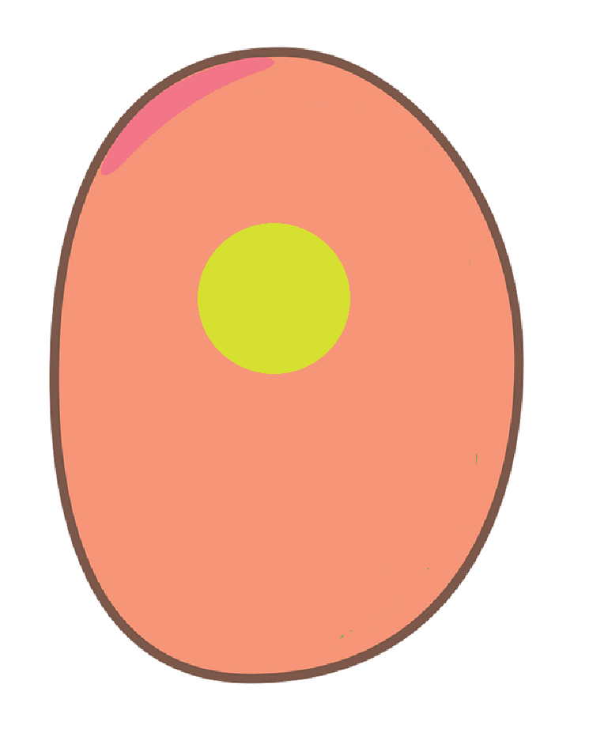
Nucleus
The nucleus is an organelle that contains a cell’s genes

Slide 11
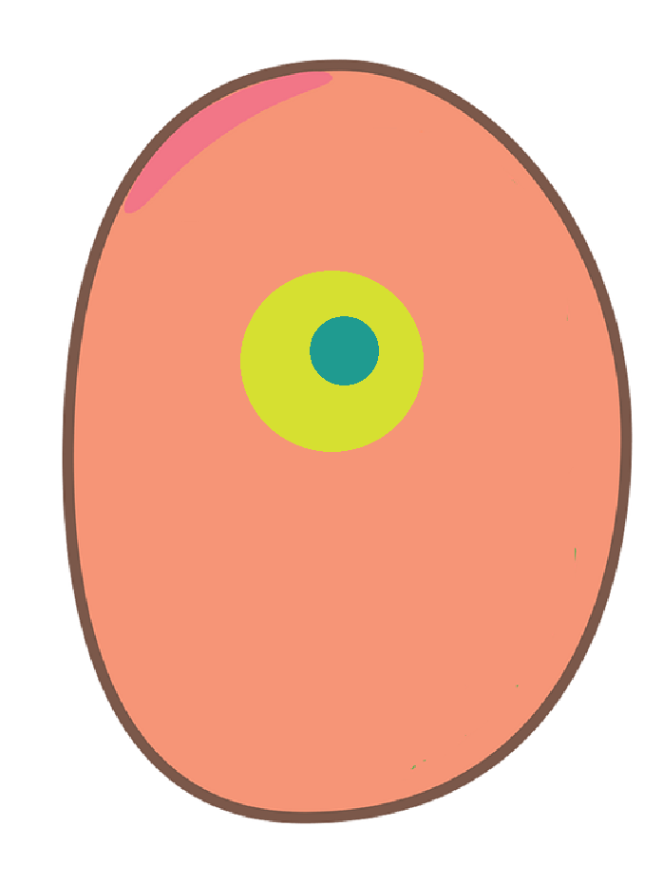
Nucleolus
The nucleolus is a sphere that produces the cell's ribosomes.

Slide 12
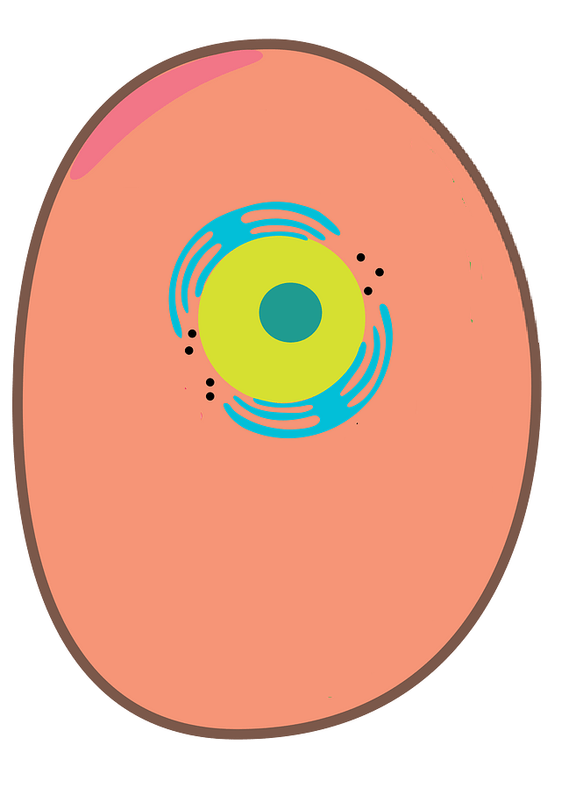
Endoplasmic Reticulum (ER) mainly transports proteins. It contains ribosomes.
Ribosomes
They make the proteins

Slide 13
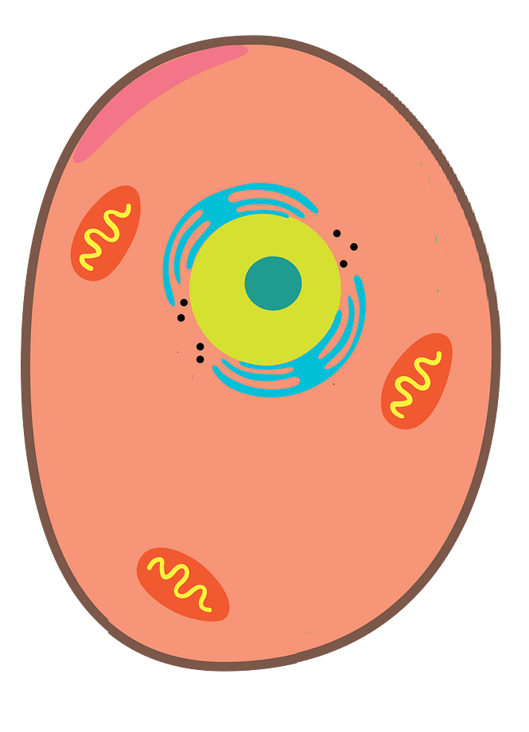
Mitochondria
Mitochondria are organelles that break down sugars (like glucose). This process releases energy that the cell can use and to do it they use oxygen.

Slide 14
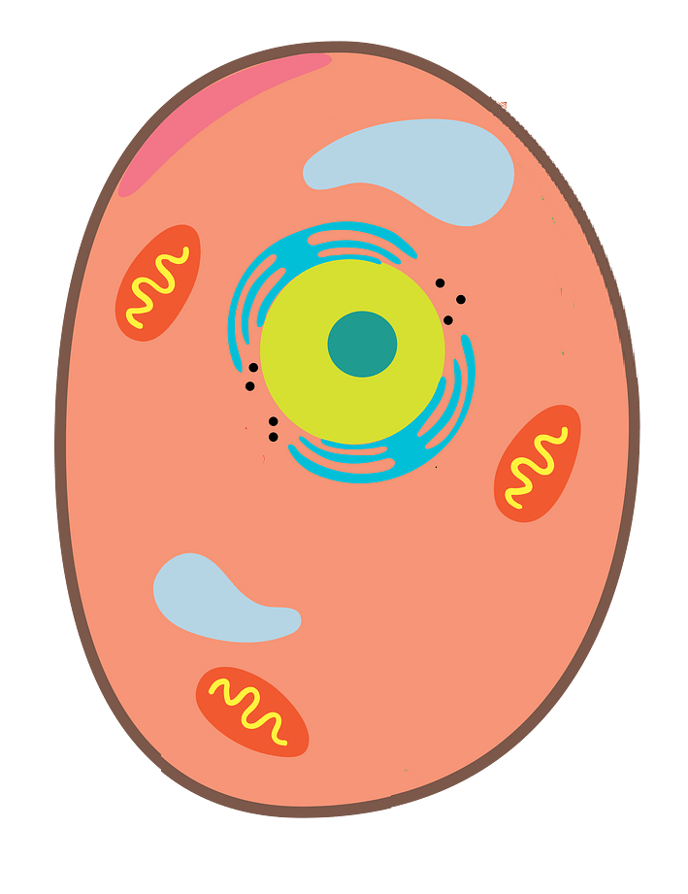
Vacuoles
Vacuole is a place where the cell stores food, water, and waste.

Slide 15
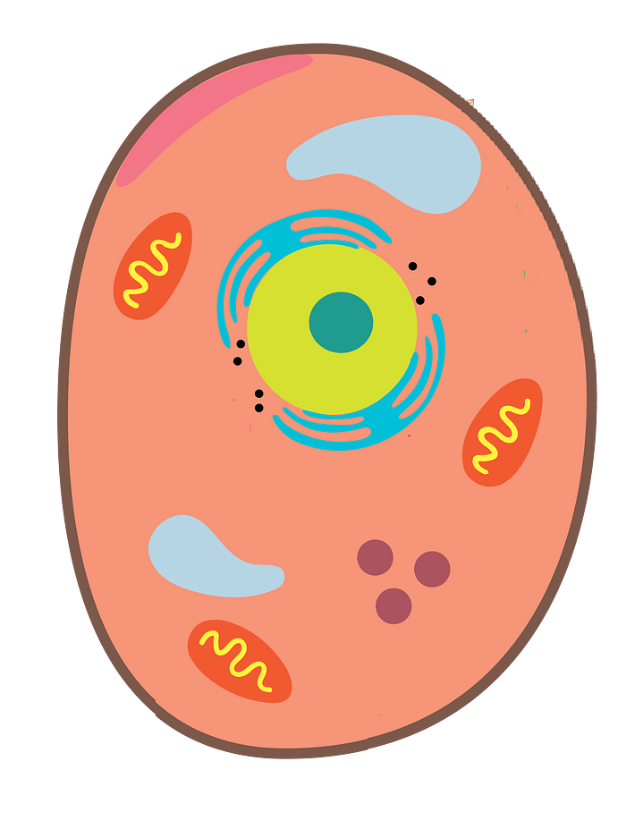
Lysosomes
They break down or recycle excess or worn out cell parts.
There are often hundreds of lysosomes in a cell.

Slide 16
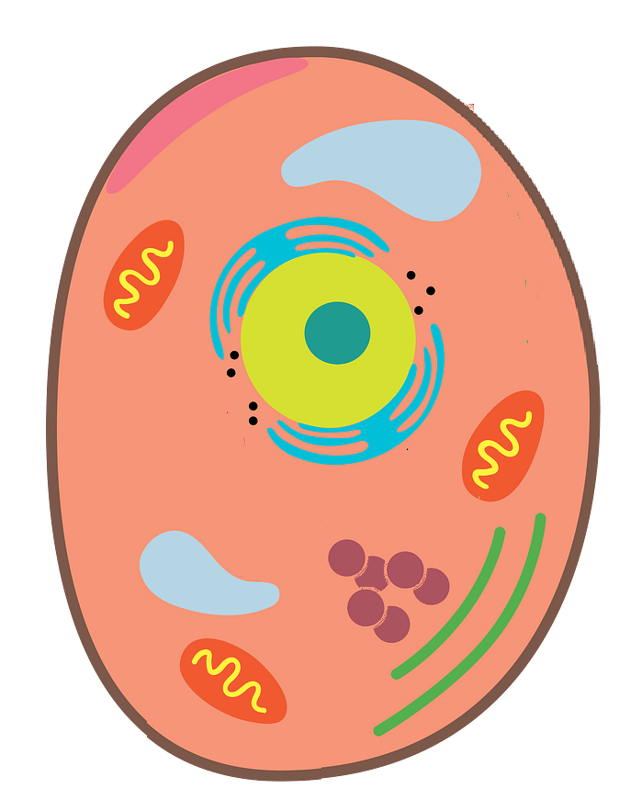
Golgi Apparatus
It puts substances into packages called vesicles, and then transports them within and outside the cell.

Slide 17
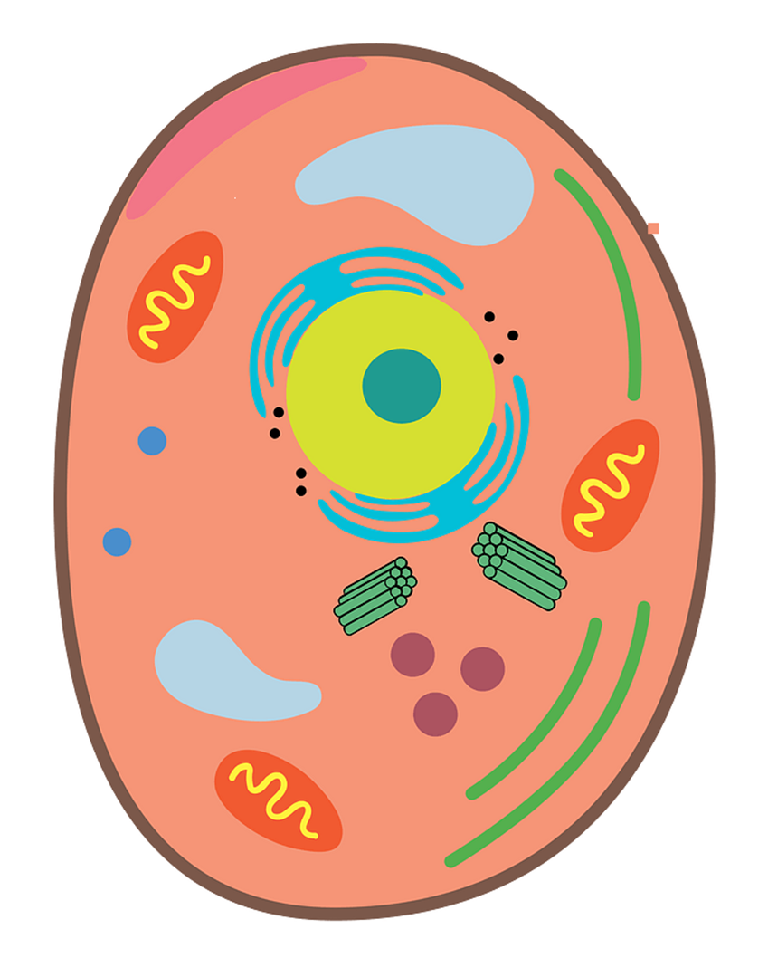
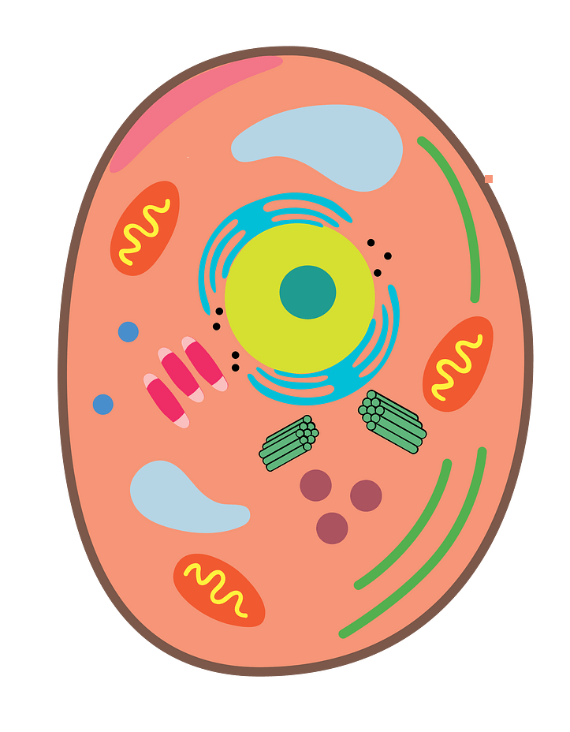
Centrioles
They play an important role in cell division.

Slide 18
