Slide 1

Compounds
Eighth Grade

Slide 2
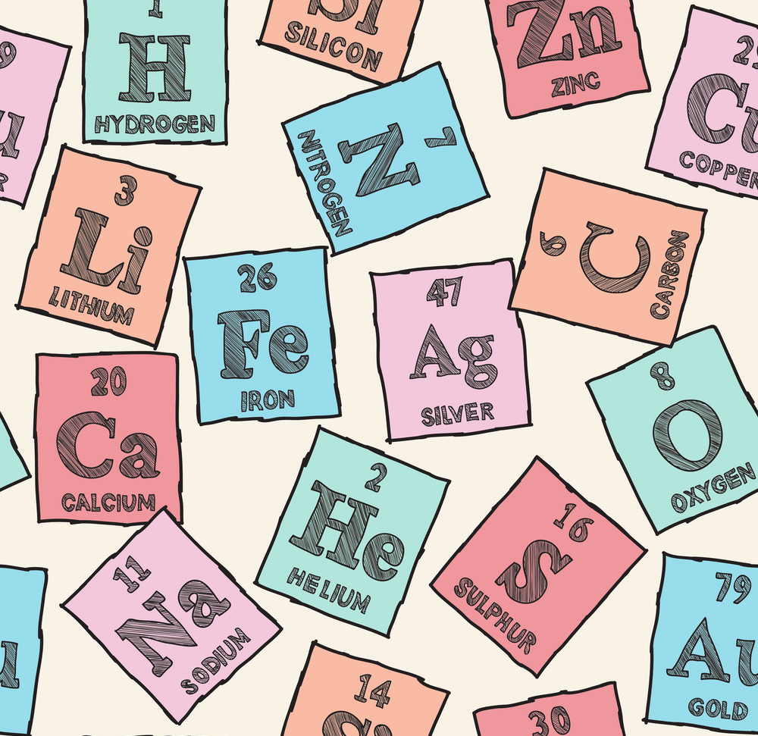
We have seen that some substances are elements.
An element is made up of only one kind of atom

Slide 3
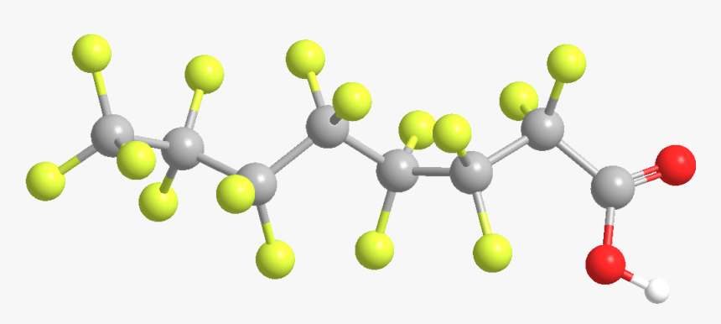
Many substances are made up of more than one kind of atom. If the different sorts of atoms are joined tightly together, then the substance is a compound.

Slide 4
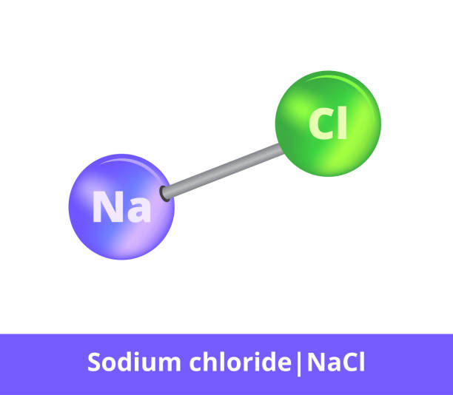
The chemical term for 2 atoms joining tightly together is BONDING. In a compound, 2 or more different kind of atoms are bonded. For example, when sodium atoms bond with chlorine atoms, they form the compound sodium chloride.

Slide 5
Properties of elements and compounds
A compound is very different from the elements from which it is made
Once two different elements are bonded, they completely lose the properties of the individual elements

Slide 6
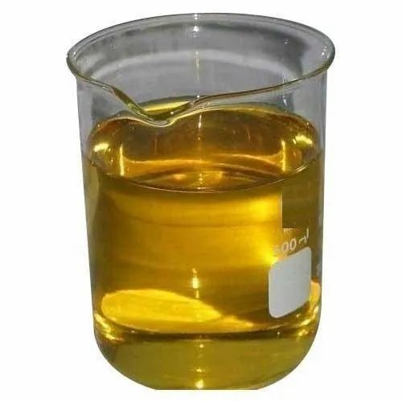
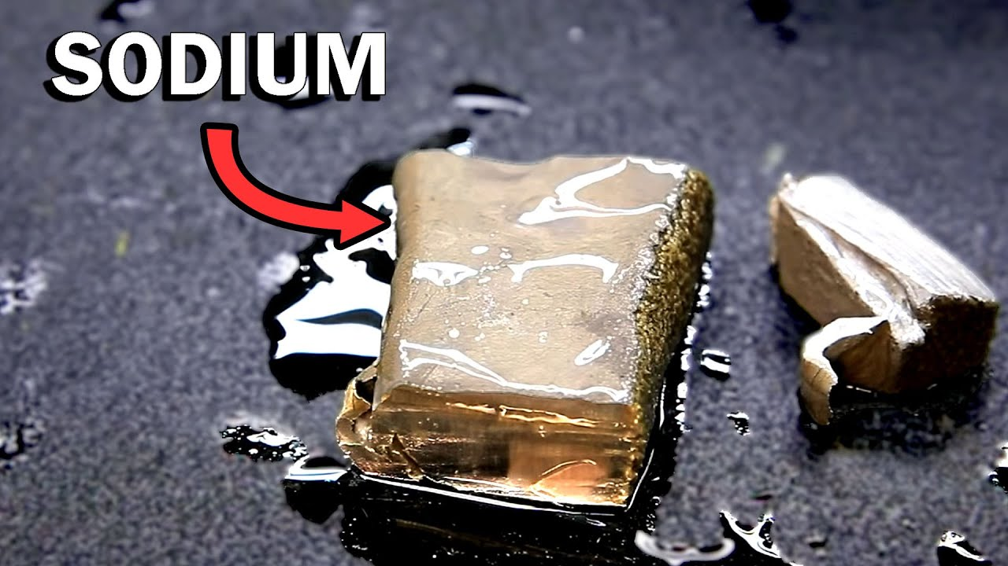


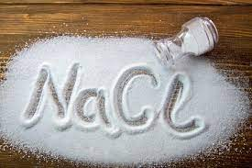

Slide 7
Can you remember the name of any compound?

Slide 8
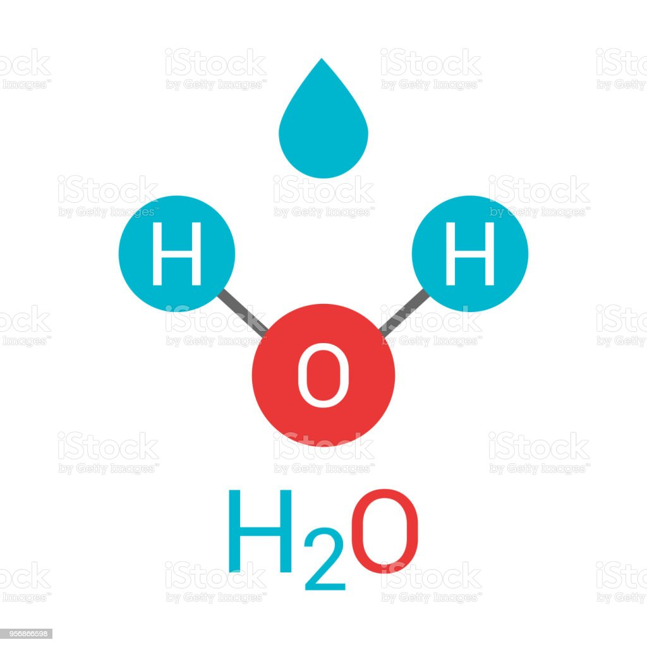
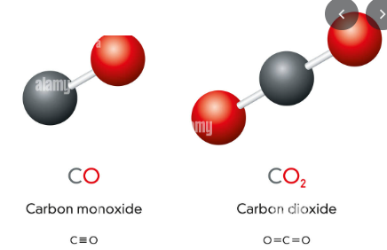
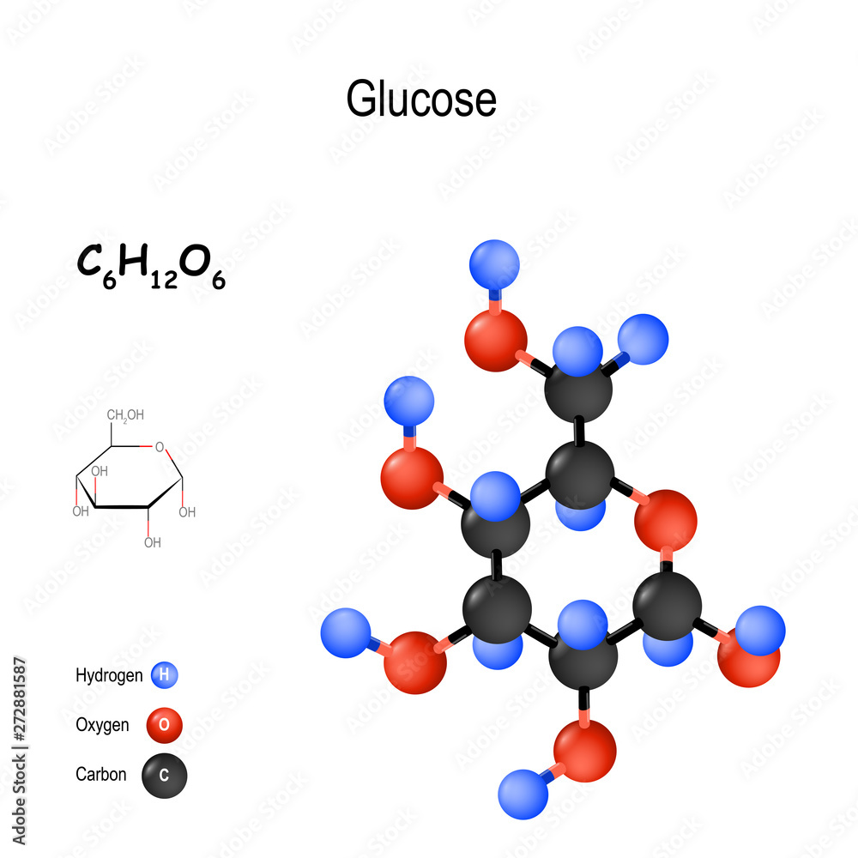

Slide 9

Naming compounds
Each compond has a chemical name. The chemical name usually tells us the elements that the compound is made from

Slide 10
Rules
If the compound contains a metal, then the name of the metal comes first in the name of the compound
P + Ca P = Phosphorus = Non metal
Ca = Calcium = Metal
Name: Calcium Phosphide

Slide 11
If the compound contains a non-metal, the name of the non-metal is usually changed. For example, the compond made from sodium and chlorine is called sodium chloride.
When two elements form a compound the name often ends in “ide”
Nitrogen
Phosphorus
Fluorine
Chlorine
Oxygen
Nitride
Phosphide
Fluoride
Chloride
Oxide

Slide 12
Rules
Some compounds contain 3 elements that include oxygen. These compounds often have names ending with “ate”
Sulfate
Nitrate
Carbonate

Slide 13
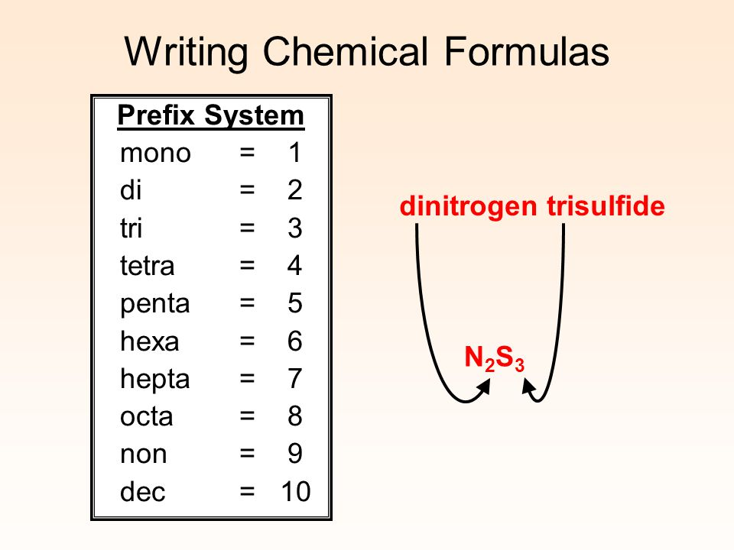
Sometimes the name of the compound tells us how many of each kind of atom are bonded together:

Slide 14

Carbon dioxide

Slide 15
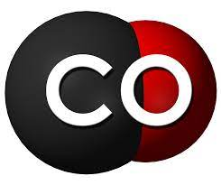
Carbon monoxide

Slide 16

Trinitrotoluene

