Slide 1
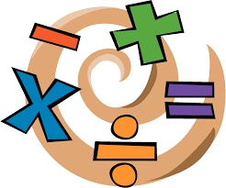
Intro to Conversion factors
EIGHTH GRADE

Slide 2
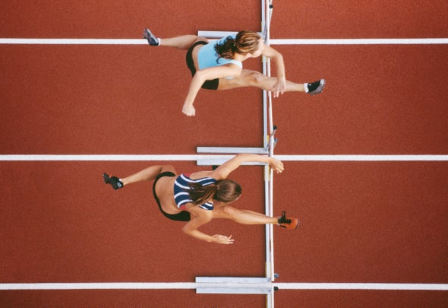
Samantha can run 150 feet in 1 minute
Valerie can run 45 meters in the same time
Which one runs faster?
Without the use of conversión factors, there is not way to know the answer, the data has different units!

Slide 3
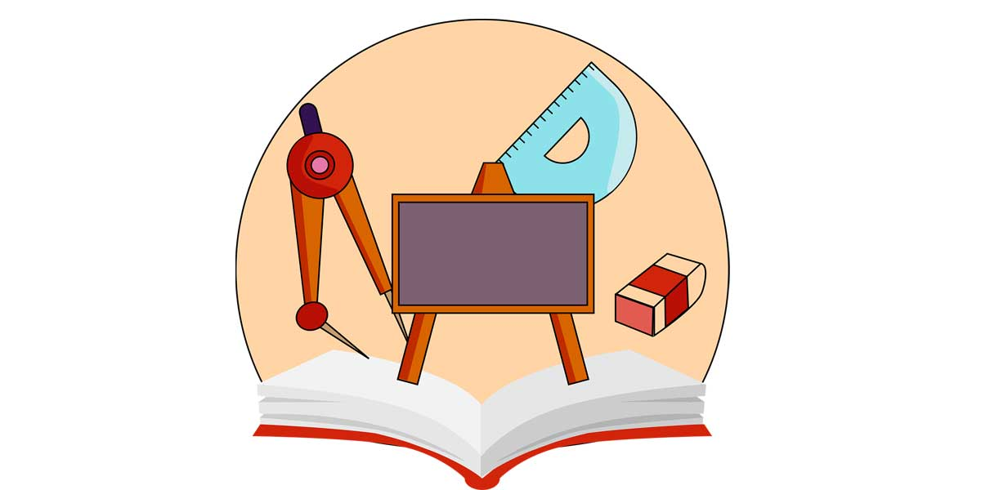
A conversion factor is a number used to change one set of units to another, by multiplying or dividing. When a conversion is necessary, the appropriate conversion factor to an equal value must be used.

Slide 4
Conversion factors have 2 parts:
1 Dollar = 3800 COP
1 Kg = 1000 g
1 hour = 60 min

Slide 5
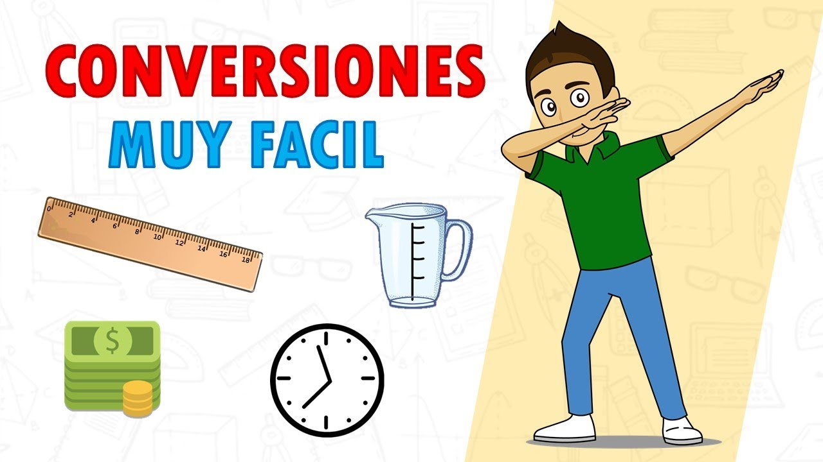

Slide 6
Conversion Factors STEP BY STEP
Exercise: Convert 3 meters to centimeters
1) Write the value you want to convert with its units:
3m
2) Then, write a multiplication sign and a line in which you will write the conversion factor:
3m X __________

Slide 7
3) Write the conversion factor in a way that the unit you want to convert is in the opposite side with the same unit:
The conversion factor is: 1 meter = 100 cm
3m X 100 cm
1m
4) Then, cancel the units that are equal and are in opposite sides:
3m X 100 cm
1m

Slide 8
5) Then you have to multiply and divide like this:
3m X 100 cm the number multiplies the numerator
1m
6) And then, it’s divided by the denominator:
300 cm Divided by
1

Slide 9

7) Finally, the result has the unit that wasn’t cancelled:
3m X 100 cm = 300 cm
1m

Slide 10
Lets practice!
Convert 3500 cm into m
Conversion factor: : 1 meter = 100 cm

Slide 11
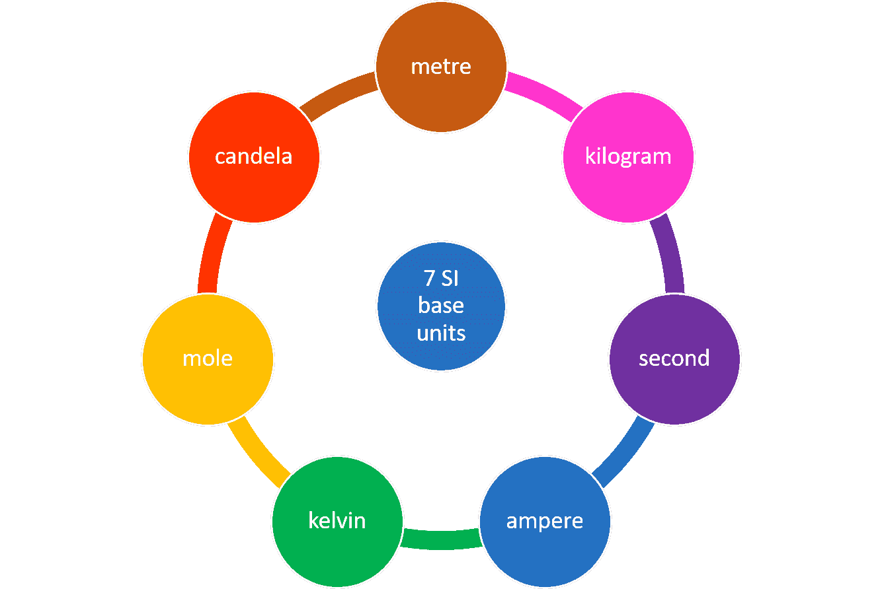

Slide 12
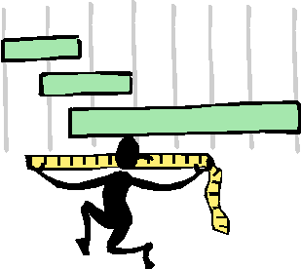
LENGTH

Slide 13
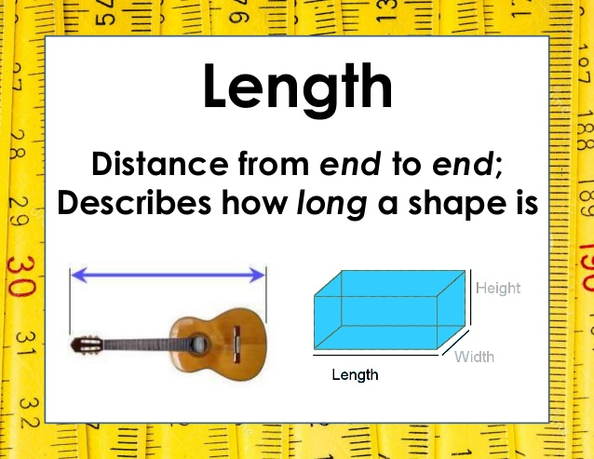

Slide 14
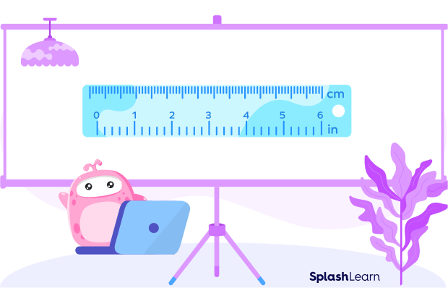
Length
Length is the term used for identifying the size of an object or distance from one point to the other. For example, the length of a ruler given below tells us how long the ruler is.

Slide 15
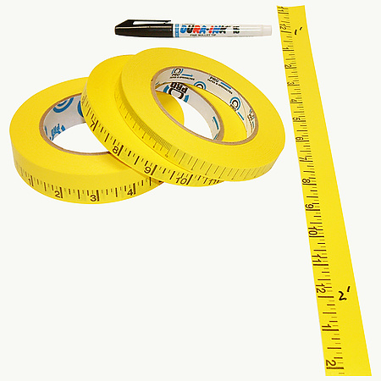
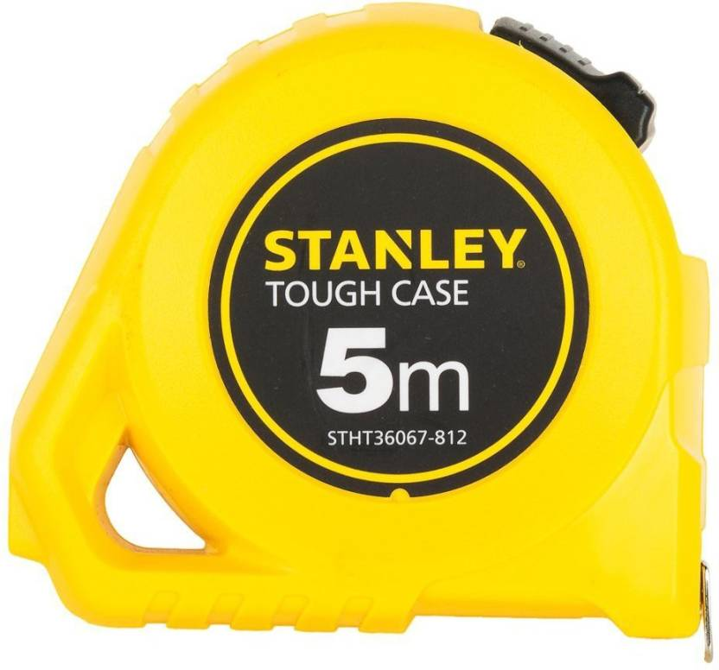
What is the name of the instrument we use to measure lenth?
Measuring tape

Slide 16

Units to Measure Length
We can measure the length of an object by using different units like meter, centimeters, feet, kilometers, miles, etc.

Slide 17
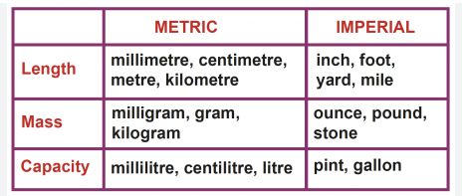

Slide 18

What is time?
Time is defined as the continued progress of existence in the past, present and future. Using the unit of time one can measure the existence of events.

Slide 19
